Slide 1




Transitioning BI Reporting from Static to Interactive Dashboards
The Shortest Distance from Data to Improvement

Slide 2
Outline :
Introduction to BI Reporting
Static Reports vs. Interactive Dashboards
Benefits of Interactive Dashboards
Key Components of Interactive Dashboards
Tools for Building Interactive Dashboards
Power BI Overview
Tableau Overview
Tableau vs Power BI Comparison
Choosing the Right Tool
Designing Interactive Dashboards
Interactivity and User Experience
Real-Time Data and Dashboards
The Shortest Distance from Data to Improvement

Slide 3
Load Testing:
Volume Testing:
Advanced Visualization Techniques
Optimizing Performance
Responsive Design in Dashboards
Common Pitfalls in Dashboard Design
Best Practices for Dashboard Maintenance
BI Dashboard Security Considerations
Future Trends in BI Dashboards
Conclusion & Next Steps
The Shortest Distance from Data to Improvement

Slide 4
Introduction to BI Reporting
What is Business Intelligence (BI)?
BI refers to the technology and practices used to Analyze and present business data.
It helps organizations make informed, data-driven decisions.
The Evolution of BI Reporting
From static, manual reports to dynamic, interactive dashboards.
Early days reporting ?
In early days we can use only static reports that made in EXCEL only or any other static reporting tool
The Shortest Distance from Data to Improvement

Slide 5
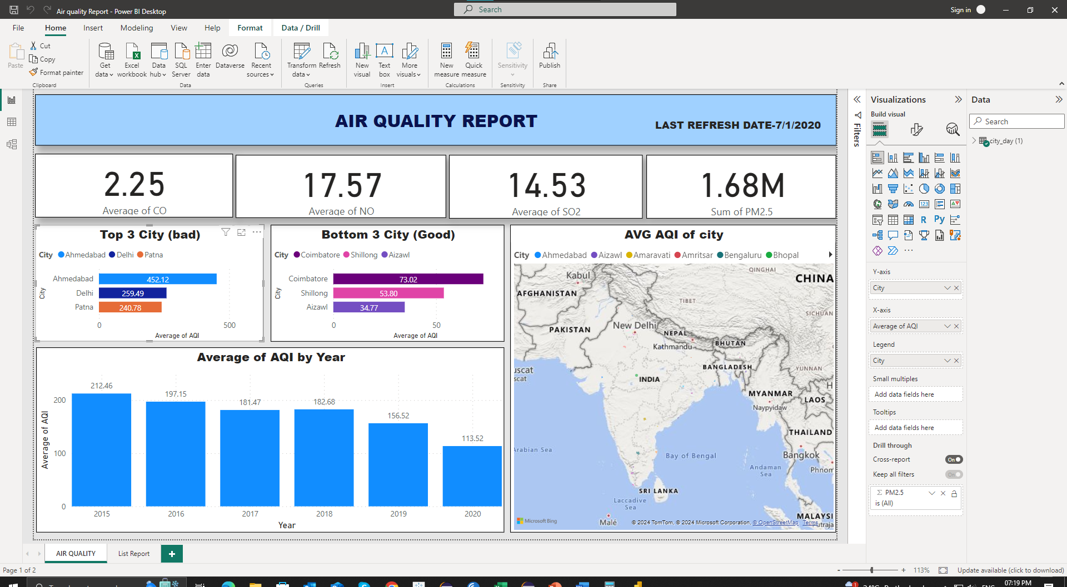
AIR QUALITY DASHBOARD
Load Testing:
Volume Testing:
In which we check application for its performance at normal and peak usage.
The Shortest Distance from Data to Improvement

Slide 6
Static Reports vs. Interactive Dashboards
Static Reports:
Fixed layout, limited interaction, typically created in Excel or PDFs.
Best for archival, compliance, or one-off reporting needs.
Interactive Dashboards:
Live, dynamic reports with interactive elements.
Enable drilldowns, real-time data, and ad-hoc analysis
The Shortest Distance from Data to Improvement

Slide 7
Benefits of Interactive Dashboards
Check Responsiveness:
1) Improved Data Exploration: Users can filter, drill down, and Analyze data on-demand.
2) Real-Time Insights: Dashboards reflect up-to-date data, ensuring timely decision-making.
3) Better Decision-Making: Visual representation helps uncover trends, patterns, and anomalies.
4) Enhanced User Engagement: Interactive features create more engaging and personalized user experiences.
The Shortest Distance from Data to Improvement

Slide 8
Key Components of Interactive Dashboards
1) Data Sources: Integration with various data sources, like databases, APIs, and cloud platforms.
2) Visualizations: Graphs, charts, tables, heatmaps, and KPIs.
3) Interactivity: Features like filters, drilldowns, dynamic text, and parameter controls.
4) User Interface: Clean and intuitive designs for easy navigation.
5) Data Refresh: Auto-refresh data and real-time alerts.
Check Responsiveness:
The Shortest Distance from Data to Improvement

Slide 9
Tools for Building Interactive Dashboards
Power BI: A Microsoft tool known for its drag-and-drop simplicity and integration with Microsoft products.
Tableau: Renowned for its powerful data visualizations and flexible interactivity.
Looker: Focuses on simple user experiences and cloud-based data exploration.
D3.js: A JavaScript library for custom interactive visualizations.
The Shortest Distance from Data to Improvement

Slide 10
Power BI Overview
What is Power BI?
Power BI is a suite of business analytics tools to analyze data and share insights.
Allows for interactive reports, data visualization, and integration with a wide range of data sources.
Key Features:
Easy-to-use interface with drag-and-drop functionality.
Integration with Microsoft tools (Excel, SharePoint, Teams).
Supports both cloud and on-premises data connections.
Publish reports to Power BI Service for sharing and collaboration.
The Shortest Distance from Data to Improvement

Slide 11
Tableau Overview
What is Tableau?
Tableau is a powerful data visualization tool that helps users understand and visualize their data in an interactive and user-friendly way.
Key Features:
Drag-and-drop interface for easy report creation.
Ability to connect to multiple data sources (including cloud and big data).
Advanced visualization options (heatmaps, tree maps, geographic maps).
Supports real-time data exploration and dynamic visualizations.
The Shortest Distance from Data to Improvement

Slide 12
Tableau vs Power BI
Power BI:
Strengths:
Better for Microsoft-centric environments (Excel, Azure).
Affordable for small to medium businesses.
Strong integration with other Microsoft tools.
Limitations:
Limited customization compared to Tableau.
Less advanced for complex visualizations.
Tableau:
Strengths:
Advanced visualizations and customizations.
Great for data exploration and in-depth analysis.
Strong community support and a wealth of resources.

Slide 13
Limitations:
Higher cost, especially for enterprise versions.
Steeper learning curve for beginners.

Slide 14
Choosing the Right Tool
Considerations:
Cost: Tableau can be more expensive, but Power BI offers a low-cost or even free version for small users.
Ease of Use: Power BI may be easier for users familiar with Excel, while Tableau has a steeper learning curve but offers more advanced visualizations.
Integration Needs: Consider the tools you already use (Microsoft products vs. diverse data environments).
Customization and Flexibility: Tableau excels in this area, while Power BI might be sufficient for most standard BI needs.
The Shortest Distance from Data to Improvement

Slide 15
Designing Interactive Dashboards
Know Your Audience: Customize dashboards based on the user's role and needs (e.g., executives vs. analysts).
Data Hierarchy: Present high-level data first, allowing users to drill down into more detailed metrics.
Visual Design: Prioritize simplicity, clarity, and visual appeal.
Use consistent color schemes and well-placed charts.

Slide 16
Interactivity and User Experience
Interactivity Features: Filters, drill-downs, tooltips, and parameter controls.
Interactive elements should support, not overwhelm, the user.
Design for Simplicity: Dashboards should be easy to navigate, even for non-technical users.
Reduce unnecessary elements and keep visualizations focused.

Slide 17
Real-Time Data and Dashboards
Importance of Real-Time Data: Dashboards should display real-time or near-real-time data to ensure relevance.
Real-Time Alerts: Set up automatic alerts when certain thresholds are reached to prompt action.

Slide 18
Advanced Visualization Techniques
Heatmaps: Used for displaying data intensity across geographical locations or time.
Geographic Maps: Helps visualize regional performance, sales distribution, etc.
Time-Series Analysis: Allows users to track changes over time and detect trends.
Waterfall Charts: Ideal for understanding how sequential data points impact an outcome.

Slide 19
Optimizing Performance
Data Load Time: Minimize the time it takes for dashboards to load by optimizing data queries.
Use aggregations and precomputed summaries to speed up performance.
Data Modeling: Ensure data is structured efficiently to reduce processing time.

Slide 20
Comparison
Feature | Excel | Power BI | Tableau
Best for | Everyday data analysis, basic reporting, and calculations | Microsoft-centric environments, small-to-mid-sized teams | Complex data analysis, advanced visualizations
User Interface | Familiar, spreadsheet-based interface | User-friendly, Excel-like experience | Intuitive, powerful for complex analysis
Cost | Included in Microsoft Office (one-time purchase or subscription) | Affordable, with a free version | Higher cost, especially at scale
Data Modeling | Basic modeling capabilities, limited to what Excel can handle | Strong with Power Query & DAX | Excellent for data blending
Visualization | Basic charts and graphs, limited interactivity | Solid, but less customizable | Highly customizable and advanced visuals
Real-Time Analytics | Limited real-time analysis capabilities without add-ins or external tools | Good, especially with Power BI Service | Excellent for real-time data feeds

Slide 21
Best Practices for Dashboard Maintenance
Regular Updates: Continuously review and update dashboards to reflect new business needs or KPIs.
User Feedback: Gather regular feedback to improve dashboard usability and interactivity.
Scalability: Design dashboards that can grow with the business as new data sources and users are added.

Slide 22
Conclusion & Next Steps
Key Takeaways
Interactive dashboards are a powerful tool for real-time decision-making and data exploration.
Choose Power BI for ease of use, integration with Microsoft products, and cost-effectiveness.
Choose Tableau for advanced visualizations, deeper data exploration, and handling large or complex datasets.

Slide 23
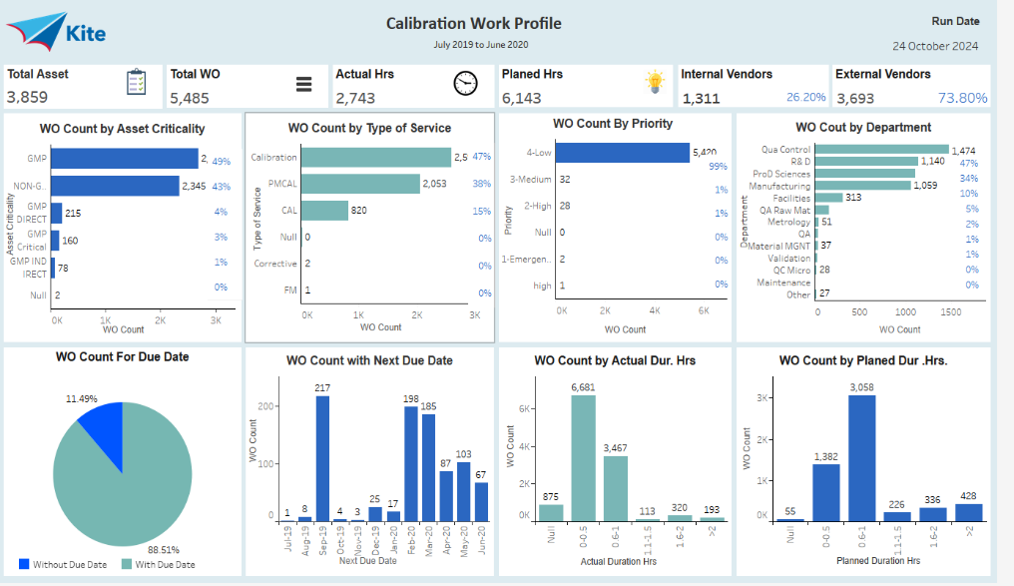
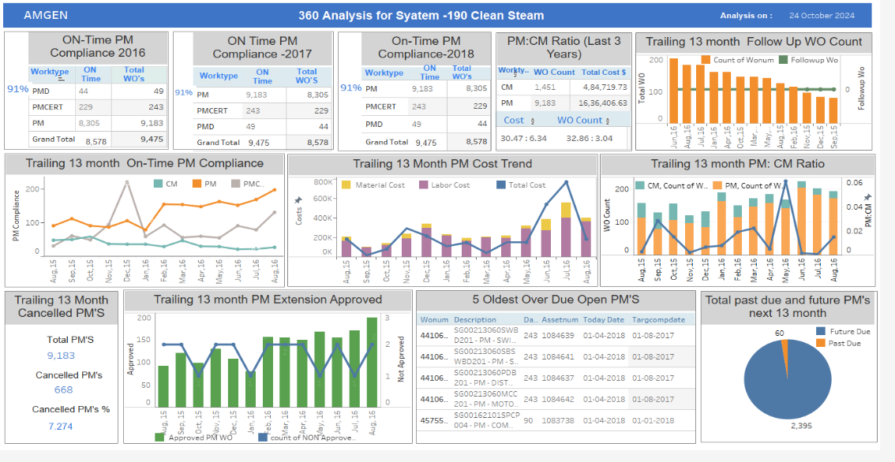
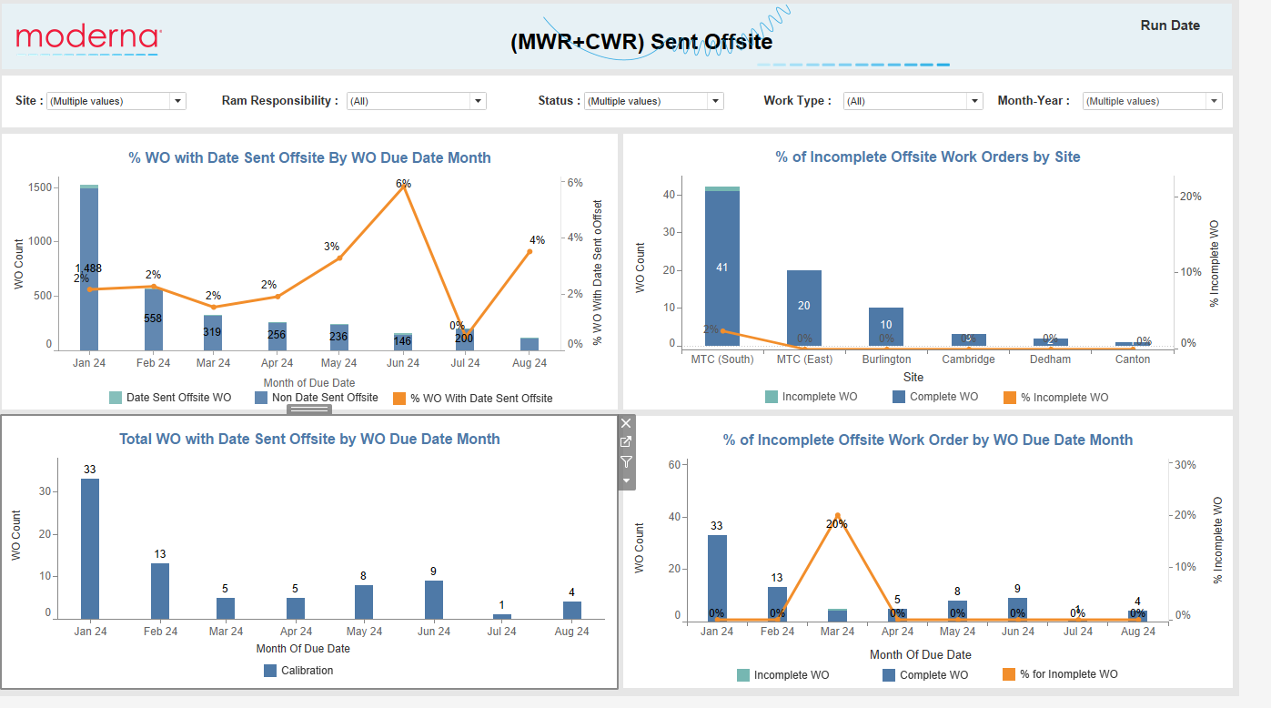
Sample Dashboard’s
The Shortest Distance from Data to Improvement

Slide 24
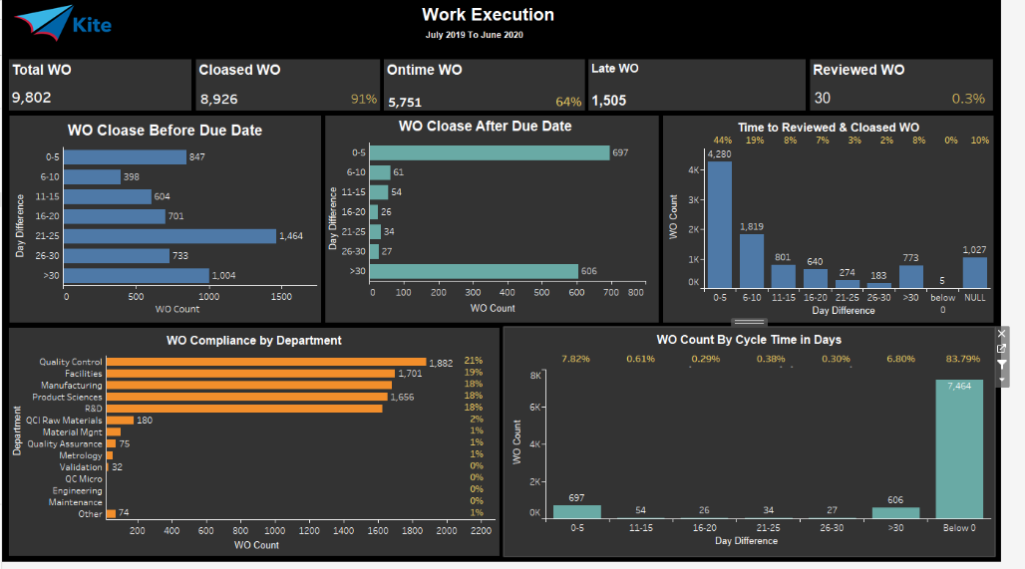
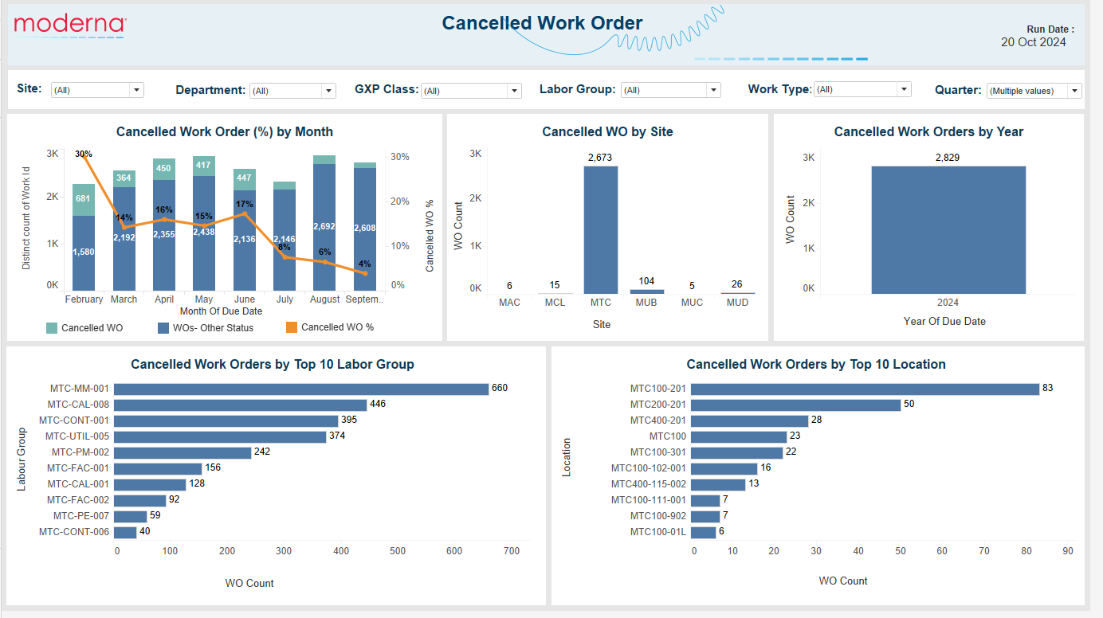
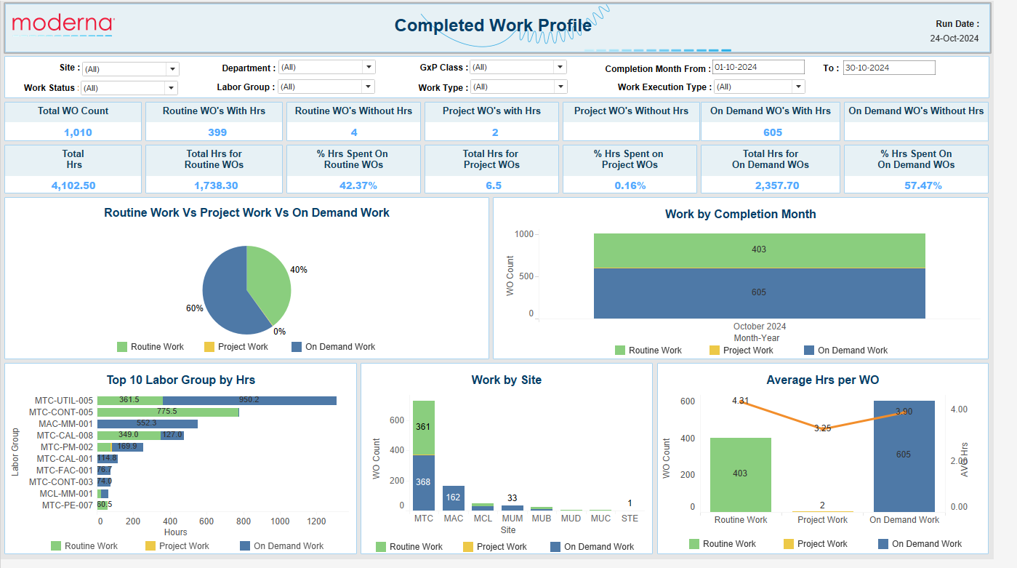
Sample Dashboard’s
The Shortest Distance from Data to Improvement

Slide 25
Any Questions ?
Thank You
The Shortest Distance from Data to Improvement

